Slide 1
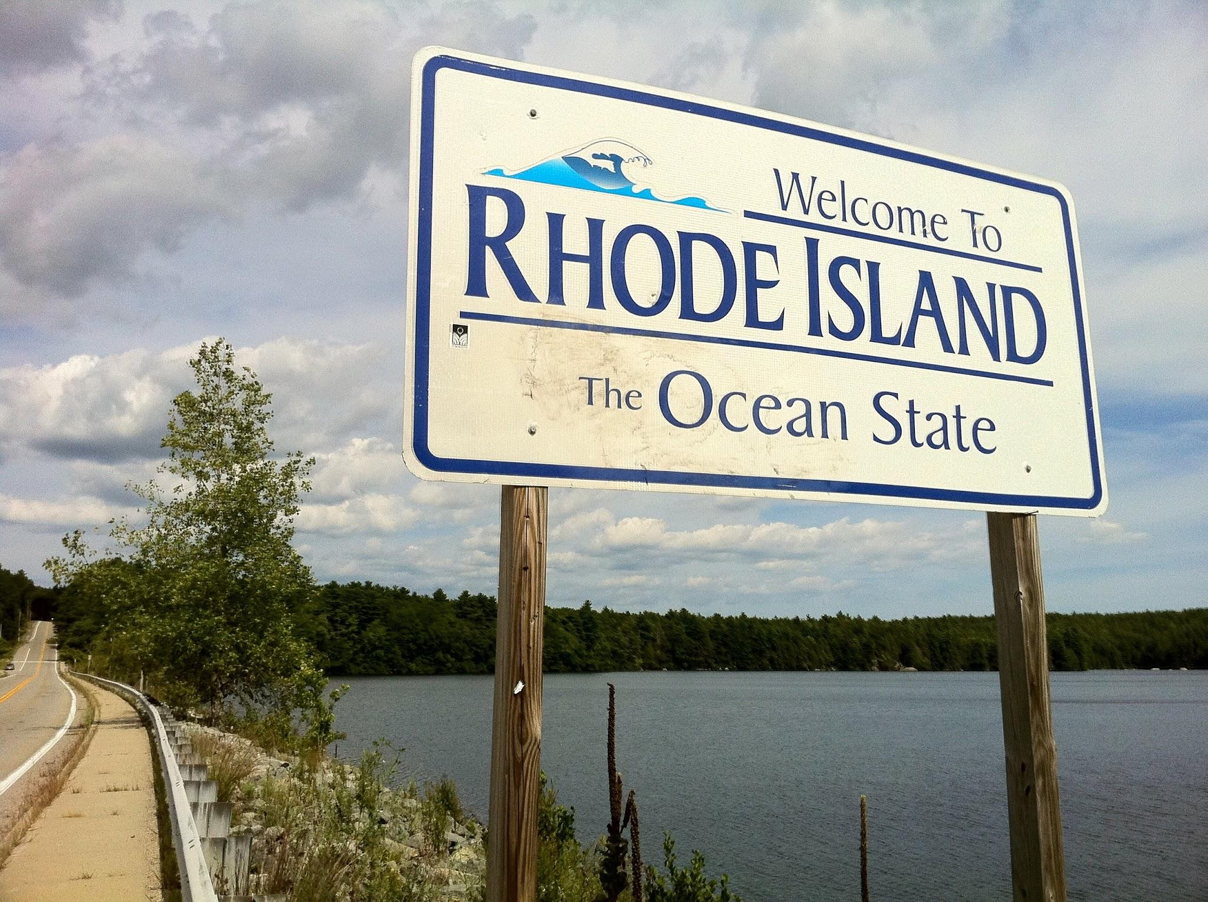
Rhode Island
By: Leah Atkins-Bostic, Rain Wilkerson, and Zora Collier

Slide 2
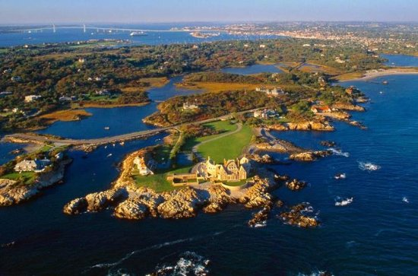
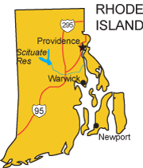
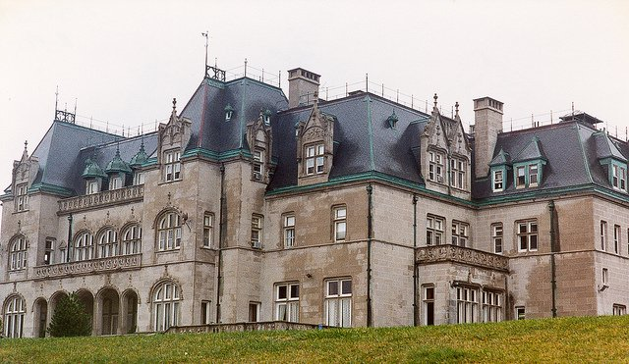
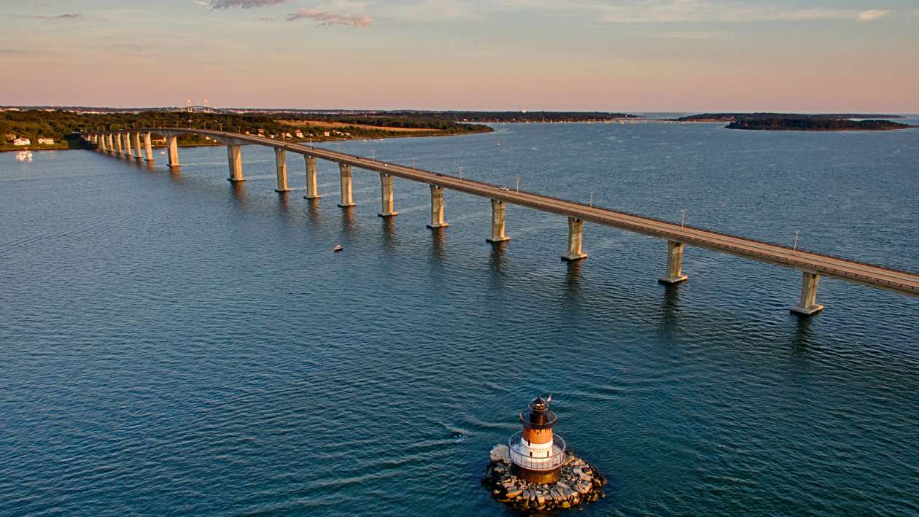
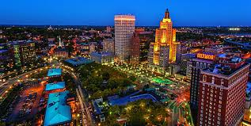
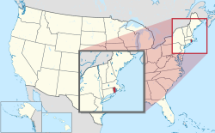
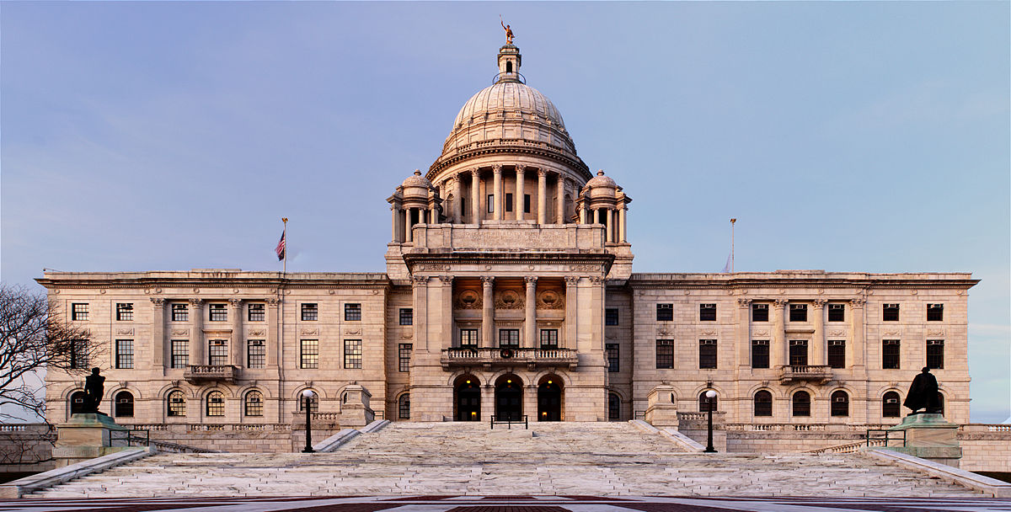
Pictures

Slide 3
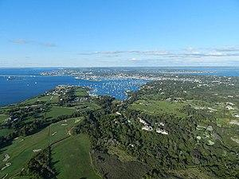
Geography
Rhode Island was founded in 1636
Some Nicknames for the Colony, Ocean State, Little Rhody , and Land
Of Roger Williams
Originally called “Roodt Eylandt”
Narragansett Bay gives Rhode Island an open door to trade from the Atlantic Ocean
Many Resources include, Fertile land, Trees, Food for Hunting and of course Water
Sixty percent of the land is forested
Rhode Island has a humid climate, with cold winters and short summers

Slide 4
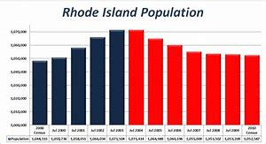
DemoGraphic
Founded by Roger Williams
Roger Williams was banished from Massachusetts because of his strong religious Beliefs
The Narragansett Indians lived there before any other Europeans and they spoke Algonquian
William Blackstone was also the very first European, Anglican man on the Colony

Slide 5
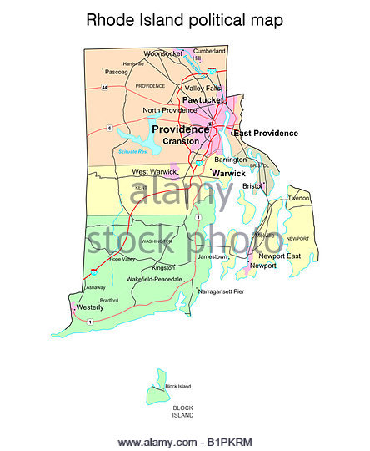
Politics
1651 England got the right to appoint a governor for Rhode Island
The governor holds the executive power
The governor’s council of Colonial Rhode Island were powerful men who supported the governor
Town meetings were held for citizens to speak

Slide 6
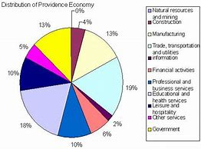
Economy
Rhode island produces..
Manufactured goods such as Cotton Cloth, Jewelry, Silverware, and Electronic products that include microchips and search and navigation equipment
Because of Rhode Island’s size, they do not support agricultural pursuits
Rhode Island’s top agricultural products are greenhouse, nursery products, sweet corn, dairy products, potatoes, and cattle
Cattle,Hogs, and Chicken all raised in state( Chicken Eggs produce important Revenue)

Slide 7
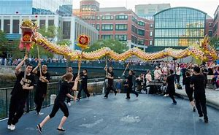
Social / Cultural
Women's Rights
Worked alongside their husbands
Did not have the right to vote
Could not inherit
Role of Religion
Had religious freedom
Became a haven for Baptists, Quakers, Jews and other minorities
Build the Touro Synagogue in 1763

Slide 8
Sources
1: : Public.gettysburg.edu. (2018). Gender and Sexuality in Colonial America. [online] http://public.gettysburg.edu/~tshannon/341/sites/Gender%20and%20Sexuality/Gender%20Roles.htm [Accessed 22 Sep. 2018].
2: NSTATE, w. (2018). Economy of Rhode Island including Rhode Island Agriculture and Manufacturing from NETSTATE.COM. [online] Netstate.com. Available at: http://www.netstate.com/economy/ri_economy.htm [Accessed 26 Sep. 2018].
3:NSTATE, www.n-state.com. "Economy Of Rhode Island Including Rhode Island Agriculture And Manufacturing From NETSTATE.COM". Netstate.Com, 2018, http://www.netstate.com/economy/ri_economy.htm. Accessed 21 Sept 2018.
4:http://www.smplanet.com/teaching/colonialamerica/colonies/rhodeisland
5:https://rhodeislandmansions.weebly.com/natural-resources.html
6:https://www.history.com/topics/us-states/rhode-island
7:http://www.city-data.com/states/Rhode-Island-Climate.html#ixzz5SFwfSuj4

Slide 9
Fun Facts
Smallest US state
Home of the Tennis Hall Of Fame
Shares a state water border with New York
Known for making silverware and fine jewelry
The first torpedo boat "Stiletto" was built in Bristol in 1887.
Last of the original thirteen colonies to become a state.

Slide 10
THANKS
for WATCHING

