Slide 1
North Carolina
By: Loni, Gabbi, Devyn

Slide 2
Geographic
North Carolina colony was founded in 1653 by the Virginia colonist.
Climate: the mountains act as a shield blocking low temperature and storms from entering the midwest of North Carolina, most areas in this state temperature is approximately 90 degrees in July , and January’s average about 50 degrees.

Slide 3
DEMOGRAPHIC
The north carolina colony was first settled in 1587.
John white discovered this colony and led 121 settlers.
By 1590 all the colonist disappeared.
The first permanent settlement was in 1655 because a virginia farmer was looking for some farmland.
Quakers were some of the first settlers.
The quakers were an important group in the politics and society of north carolina.
Established religious freedom
People also attempted to set up anglican churches until the 1700.
The Official language north carolina spoke was english
90% english -6% spanish -2% other
http://www.citethisforme.com/cite/sources/websiteautociteconfirm
https://www.ncpedia.org/

Slide 4
Political
The government is set up in three different branches.
Executive, Judicial and Legislative.
Women make less than men in every state. In American women are paid an average of only 78%
North Carolina is ranked number 9 in terms of difference in earnings between men and women
North Carolina is politically dominated democratic and republican political parties.
In a normal election the state of north carolina votes republican in 9 of the last 10 elections.
https://www.newsobserver.com/opinion/op-ed/article122593759.html
https://www.trumanlibrary.org/whistlestop/teacher_lessons/3branches/1.htm
http://www.actionnc.org/sww

Slide 5
Climate!
Annual high temperature is 70.8 degrees
Low temperature is 48.8 degrees
Average temperature is 59.8 degrees
Average annual precipitation 41.63 inches of rain.

Slide 6
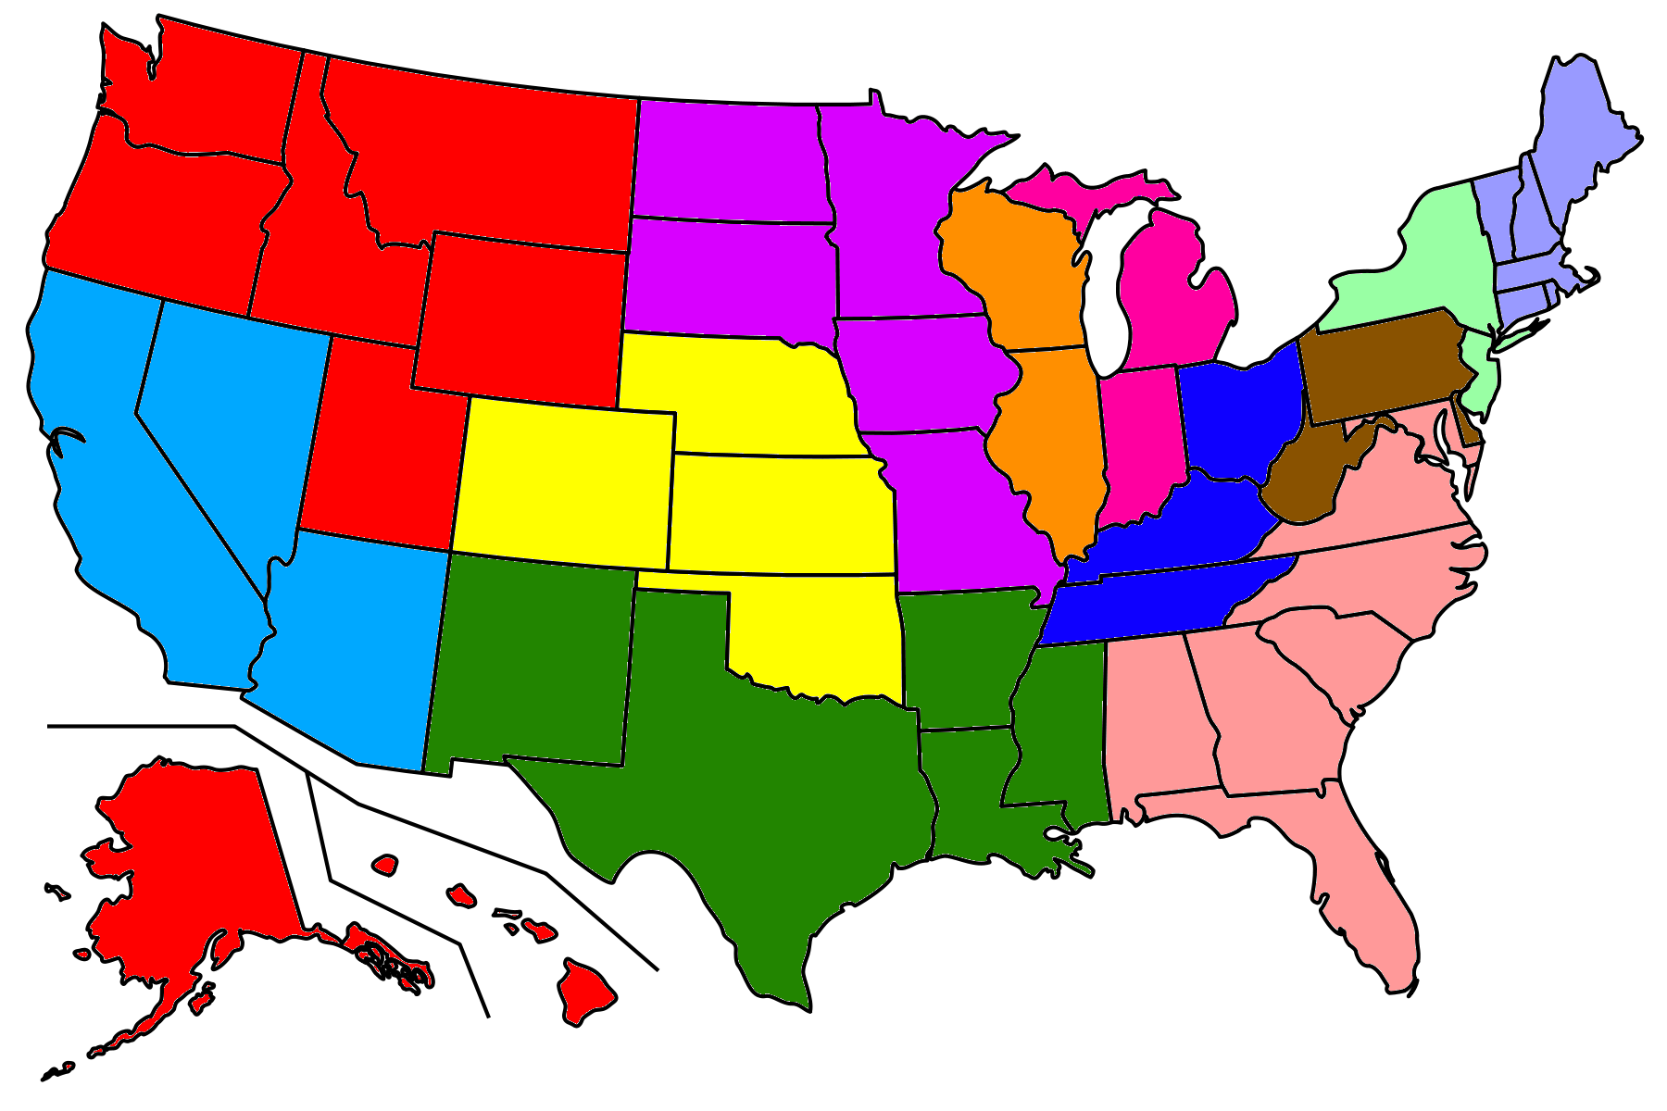
Major changes in North Carolina territory
North Carolina is A state in the North Carolina and Georgia to South Carolina , and North Carolina is the 28th extensive (meaning:covering or affecting a large area.) North Carolina is one of 13 colonies and the territory of North Carolina is south carolina and was originally called Province of Carolina. The northern and southern were separated in 1729 and actually the first people to settle on it were farmers and some slaves.
https://en.m.wikipedia.org/wiki/North_Carolina

Slide 7
Natural resources & Region
The forests take millions acres of North Carolina (fact:forests products make up states largest manufacturing industry)
Minerals
Waterways
Natural diversity- significant to the state economy and quality of life.
*(EXAMP: forest/estuaries for tourists and their dollars , habitats (wildlife)
https://sciencing.com/list-north-carolinas-natural-resources-7454040.html
Region- is a southeastern U.S with a landscape ranging from Atlantic ocean beaches to the Appalachian mountains.
( Facts: charlotte is the largest city and the capital: Raleigh)
https://en.wikipedia.org/wiki/North_Carolina

Slide 8
Social and Cultural values
North carolina's culture was not really based off of the arts, however many Native Americans made plates, pots and bowls.
The Scotch-Irish had the biggest impact on the culture of north carolina, as they brought with them their presbyterian faith
There are little to no arts or writing that really defined north carolina at the time. Overall, north carolina did not contribute to the U.S. as a whole
Eastern North carolina has been citadel of the states colonial history of european cultural heritage ever since the lost colony.
In recognition of North Carolina’s Unique history and cultural heritage and arts council was established in 1964
https://www.britannica.com/place/North-Carolina-state/Cultural-life

Slide 9
FUN….. FACTSSSS
North Carolina is the largest producer of sweet potatoes in the nation.
North Carolina had 1,500 lakes of 10 acres and more in size and 37,000miles of freshwater streams.
Babe Ruth hit his first professional home run in fayetteville on March 7 , 1914.
North Carolina is famous for the First in flight- Wright brothers.
http://www.hickorync.gov/content/things-north-carolina-famous
https://www.50states.com/facts/north-carolina.htm

Slide 10
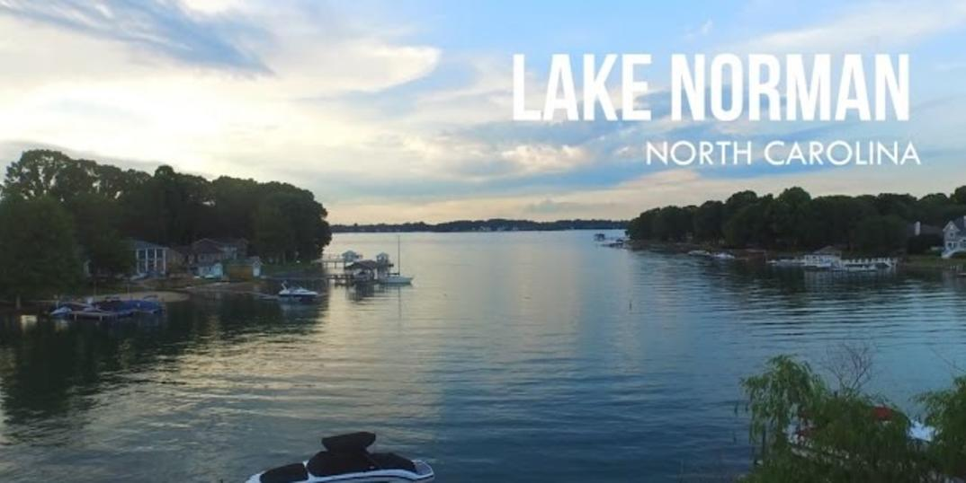
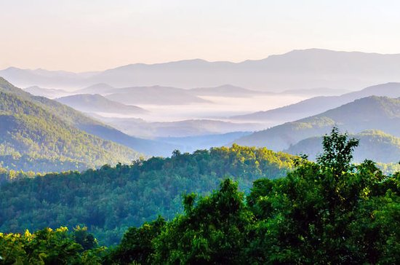
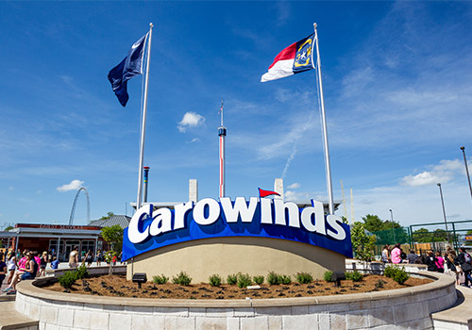
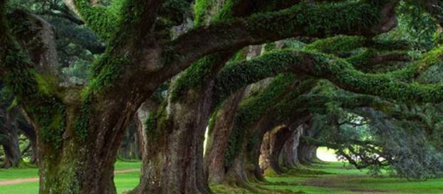
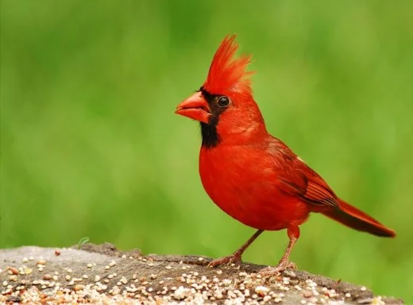
Notes:
Blue ridge Mountains,Legacy tree fund, Fantasia was born in High point NC and the Cardinal bird is found in North Carolina

Slide 11
CREDITS!!!!!!!!!!!
Geographic- LONI
Demographic- Devyn
Political- GABBI
Social and cultural values- Gabbi ( Mickey)
Climate - LONI
Major changes - LONI
Natural resources and region- LONI
Fun facts- GABBI
Pictures- GABBI
Credit page- GABBI

Slide 12
The END !!!!!!!!!

