Slide 1
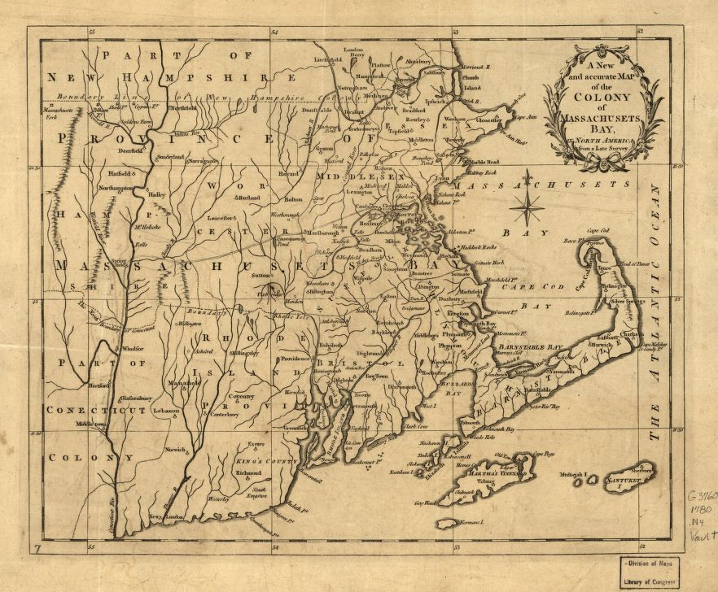
mass
Massachusetts Bay Colony
/
This is why our colony is better than yours
https://www.loc.gov/item/20016203
ByDaria Lapidot-Boaz, Mai Le, Zie Means and
Phelix Sturdivan

Slide 2
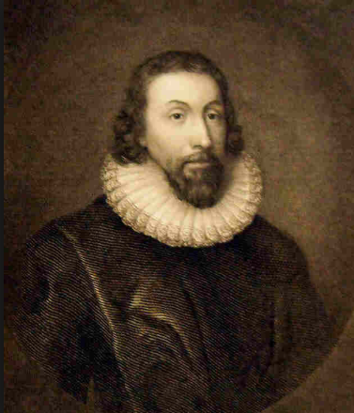
Geography
Massachusetts Bay colony was established by a group of Puritans led by John Winthrop in 1630. During the Great Puritan migration
It joined the union. And became a state in February 6, 1788 by the Massachusetts Bay company as Massachusetts.
The climate was humid warm summers and very snowy cold winters. "Massachusetts Bay Colony | Facts, Map, & Significance". Encyclopedia Britannica, 2018 https://www.britannica.com/place/Massachusetts-Bay-Colony. Accessed 24 Sept 2018. "States - Ranked By Date That State Entered The Union - Ipl2 Stately Knowledge: Facts About The United States". Ipl.Org, 2018, http://www.ipl.org/div/stateknow/dates.html. Accessed 24 Sept 2018.
/www.landofthebrave.info/john-winthrop.htm

Slide 3
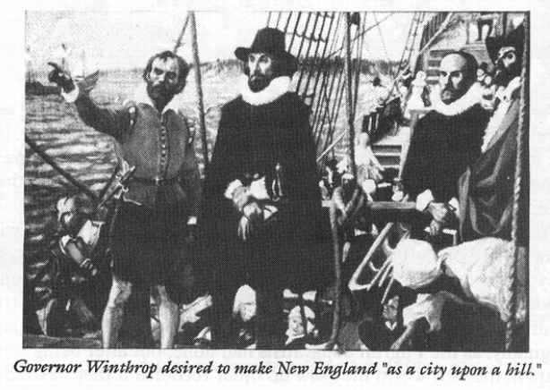
Massachusetts Bay colonies natural resources and materials were. Fur, timber from the thick forest., Fish from the lakes, rivers and salt marshes. And from Cape cod whale.
Because of the poor soil. Farming was difficult for some crops . But crops like pumpkin, beans and corn grew.
The region of Massachusetts Bay colony is New England.
Average low temperature: 29*F Average high
temperature 82*F
"Colonial Massachusetts ***". Landofthebrave.Info, 2018, https://www.landofthebrave.in
fo/colonial-massachusetts.htm. Accessed 24 Sept 2018. Edc.uri.edu. (2018). RI Salt Marshes. [online] Available at: http://www.edc.uri.edu/restoration/html/intro/salt.htm [Accessed 25 Sep. 2018].
Data, U. (2018). Climate Massachusetts - temperature, rainfall and average. [online] Usclimatedata.com. Available at: https://www.usclimatedata.com/climate/massachusetts/united-states/3191 [Accessed 24 Sep. 2018].
http://endtimepilgrim.org/puritans02.htm

Slide 4
Massachusetts Bay Economy
Massachusetts Bay colony made money by, fishing and shipbuilding.
They also Traded fur, whale and timber
They Participated like many New England colonies in the Triangle trade. By exporting things like Rum for Slaves.
Puritans feared that economic affairs could distract them from husbandry. But changed their minds when the economy got into their first depression, in 1640.
Slavery was a big part of the economy. Many people bought and sold slaves. The Evolution of the City of Boston. (2018). Exports and Imports - The Evolution of the City of Boston. [online] Available at: http://kesmith.blogs.wm.edu/imports/ [Accessed 25 Sep. 2018]. Brooks, R. and &rarr;, V. (2018). History of the Massachusetts Bay Colony. [online] History of Massachusetts. Available at: http://historyofmassachusetts.org/history-of-the-massachusetts-bay-colony/ [Accessed 25 Sep. 2018].

Slide 5
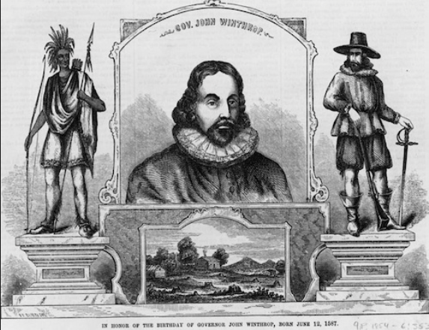
Demographic
Puritans:
Massachusetts was established because Puritans were persecuted for their beliefs. They believed the church of England to be to much like the Catholic church.
Wanted to build city on a Hill
http://jesselatour.blogspot.com/2013/01/john-winthrop-and-religious-liberty.html

Slide 6
Demographic
John Winthrop led the Puritans and established Massachusetts.
The Puritans came from England.
The Puritans believed God wanted them to live according to what the Holy scripture said.
They tried many times to purify the Church of England.
Study.com. (2018). Puritans in America: Beliefs, Religion & History - Video & Lesson Transcript | Study.com. [online] Available at: https://study.com/academy/lesson/puritans-in-america-beliefs-religion-history.html [Accessed 24 Sep. 2018]. https://www.britannica.com/place/Massachusetts-Bay-Colony. Accessed 24 Sept 2018. "States - Ranked By Date That State Entered The Union - Ipl2 Stately

Slide 7
Puritans social and cultural life
John Winthrop was the first Governor of Massachusetts Bay colony after he led the Puritans in to the Great migration.
Many people like to say that Massachusetts was a mans world. Puritans believed women were weak.
Women were by far lower ranking than man. That means they couldn't sign contracts, possess property or own a business. Unless widowed. Encyclopedia Britannica. (2018). Massachusetts Bay Colony | Facts, Map, & Significance. [online] Available at: https://www.britannica.com/place/Massachusetts-Bay-Colony [Accessed 24 Sep. 2018].History of American Women. (2018). Puritan Women's Rights | History of American Women. [online] Available at: http://www.womenhistoryblog.com/2007/10/puritan-women.html [Accessed 24 Sep. 2018].

Slide 8
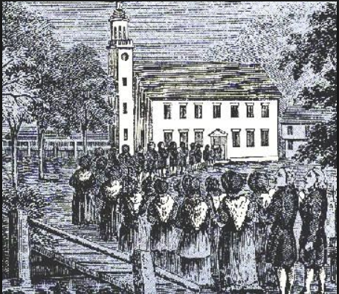
The Puritans were not tolerant of other religious beliefs.
They broke of from the Church of England because they felt like it strayed from what god intended.
They believed they were the only true religion and seeked religious freedom just for the puritans.
Church was mandatory. There was usually a service once a week that was several hours long and one on Sunday that took all day. At a meeting house.
Missing church would mean you had to pay a fine. Brooks, R. and &rarr;, V. (2018). History of the Massachusetts Bay Colony. [online] History of Massachusetts. Available at: http://historyofmassachusetts.org/history-of-the-massachusetts-bay-colony/ [Accessed 24 Sep. 2018].
Thirteen.org. (2018). Freedom: A History of US. Webisode 3: Liberty for All? Segment 2 | PBS. [online] Available at: https://www.thirteen.org/wnet/historyofus/web03/segment2.html [Accessed 24 Sep. 2018].
Religion
https://www.pinterest.com/pin/543317142516724454/?lp=true

Slide 9
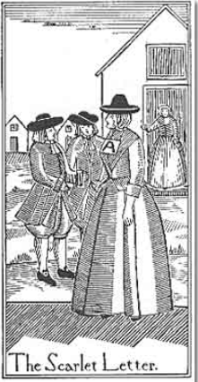
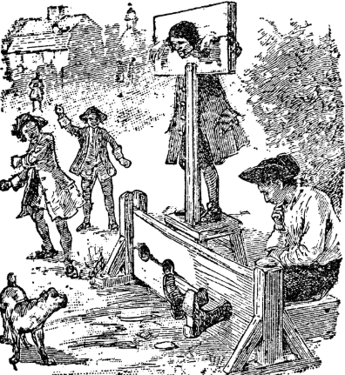
Punishments
/www.whaleoil.co.nz/2017/06/people-named-sh
The puritans believed in Punishments
If you got caught cheating you would be forced to wear a scarlet A.
If you committed a crime you would get a public whipping or put in a stockade. So people passing by can laugh and spit at you.
https://www.tes.com/lessons/uEjarcc5EGgnZw/tsl-chapters-21-22

Slide 10
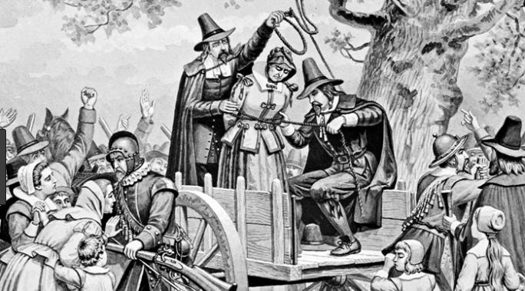
\\
If you failed to do something in the community you would also get a punishment
The puritans also believed in the supernatural.
If you got suspected of being a witch you would get a trial then hung Ushistory.org. (2018). Puritan Life [ushistory.org]. [online] Available at: http://www.ushistory.org/us/3d.asp [Accessed 24 Sep. 2018].
Editors, H. (2018). Salem Witch Trials. [online] HISTORY. Available at: https://www.history.com/topics/colonial-america/salem-witch-trials [Accessed 24 Sep. 2018].
https://www.christianitytoday.com/history/issues/issue-41/witch-hunting-in-salem.html

Slide 11
Political
Massachusetts established a Theocratic Government.
There government was limited to church members.
The Government and Religion were extremely intertwined.
Only devoted male Puritans could participate in decision making.
Brooks, R. and &rarr;, V. (2018). History of the Massachusetts Bay Colony. [online] History of Massachusetts. Available at: http://historyofmassachusetts.org/history-of-the-massachusetts-bay-colony/ [Accessed 24 Sep. 2018].

Slide 12
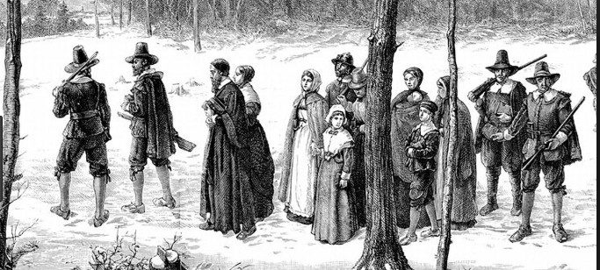
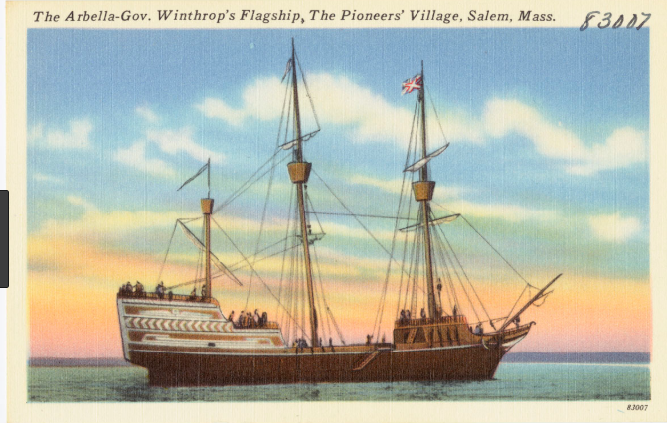
https://www.google.com/search?biw=1094&bih=474
://www.google.com/search?q=mass+bay+colony&source=lnms&tbm=isch&sa=X&ved=0ahUKEwip4O7tt9fdAhVC5YMKHaSyD3AQ_AUIDygCgC
https://www.google.com/search?biw=1094&bih=474&tbm=isch&sa=1&ei=5dWqW6DyKoHLjwTW2a-YAg&q=puritains+ship&oq=puritains+ship&gs_l=img.3...517404.523347..524227...0.0..4.95.2152.27......2....1..gws-wiz-img.....0..0j0i24j35i39j0i67j0i10j0i30j0i5i30j0i10i24.pjr8SOEgOTE#imgrc=UeMmnr6VJQ7t5M:
The End!

