Slide 1
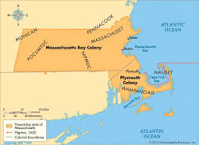
Massachusetts
By: Merly, Ryan , Iyania

Slide 2
Geographic
¹In 1630 the Massachusetts Bay Colony was founded by John Winthrop with other Puritans
²The Massachusetts Colony was named after an Algonquin tribe that previously lived their
³There were many jagged coasts and hills, with mountains covered with trees and rivers, but there was poor soil which made farming very difficult but they could still farm other foods like corn, pumpkins, rye, squash and beans
⁴The summers were short and warm, while the winters were long freezing
⁵There were many fish, whales, forests, they also got many agricultural tools imported from other colonies
(https://www.landofthebrave.info/massachusetts-colony.htm)(9/19)

Slide 3
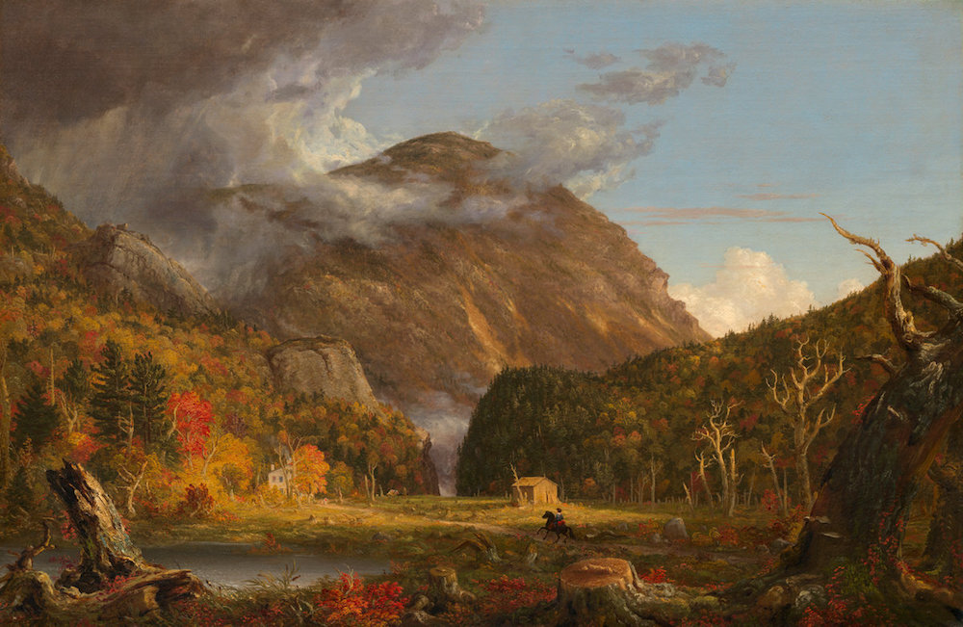
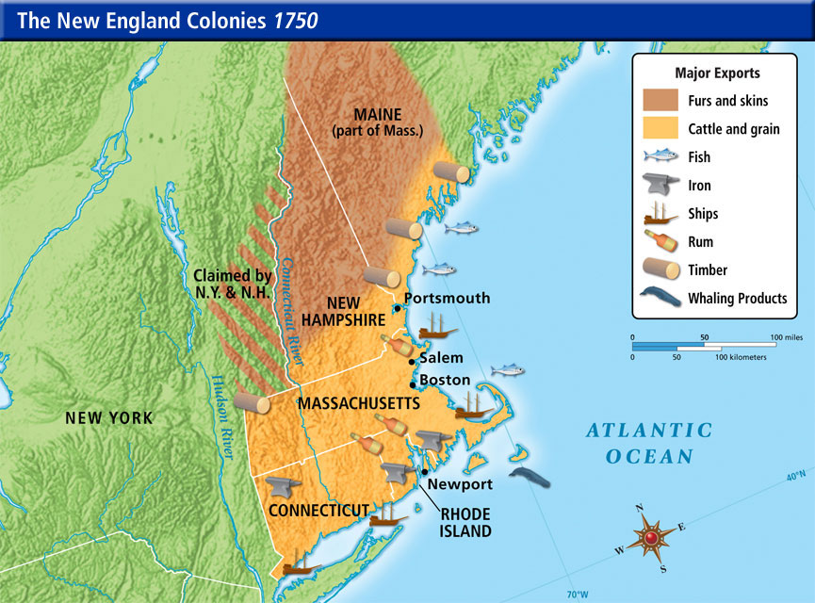

Slide 4
Demographic
Massachusetts was established because a foundation was laid for another colony in new england so they made it Massachusetts.¹
Massachusetts was established by John Winthrop.²
In 1630 a group of 1,000 puritan refugees came, came from england ²
Most people speak english but some speak spanish and portuguese.²
In the 1800s a widespread of irish immigrants was catholic and everyone that lives there now is catholic too.³
Celebrateboston.com. (2018). History of the Massachusetts Bay Colony, 1628-1664. [online] Available at: http://www.celebrateboston.com/history/massachusetts.htm [Accessed 21 Sep. 2018].¹
Encyclopedia Britannica. (2018). Massachusetts Bay Colony | Facts, Map, & Significance. [online] Available at: https://www.britannica.com/place/Massachusetts-Bay-Colony [Accessed 21 Sep. 2018].²
World Travel Guide. (2018). Massachusetts - World Travel Guide. [online] Available at: https://www.worldtravelguide.net/guides/north-america/united-states-of-america/massachusetts/history-language-culture/ [Accessed 21 Sep. 2018].³

Slide 5
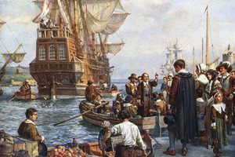

Slide 6
Social/Cultural
The Massachusetts Bay Colony were led by wealthy and powerful puritans who followed first John Winthrop, and then Thomas Dudley³
Women were not allowed in town meetings and were excluded from making decisions in church ²
Women were treated harshly and were seen as instruments of the devil ²
Massachusetts Bay Colony was a puritan society
No religious freedom in the colony, (everyone was a puritan)¹
Followed god’s law and would be punished if not¹
Puritan Life [Ushistory.Org]". Ushistory.Org, 2018, http://www.ushistory.org/us/3d.asp. Accessed 21 Sept 2018. ¹
History of American Women. (2018). Massachusetts Bay Colony | History of American Women. [online] Available at: http://www.womenhistoryblog.com/2007/10/massachusetts-bay-colony.html [Accessed 21 Sep. 2018].² Encyclopedia Britannica. (2018). Massachusetts Bay Colony | Facts, Map, & Significance. [online] Available at: https://www.britannica.com/place/Massachusetts-Bay-Colony [Accessed 24 Sep. 2018] ³

Slide 7
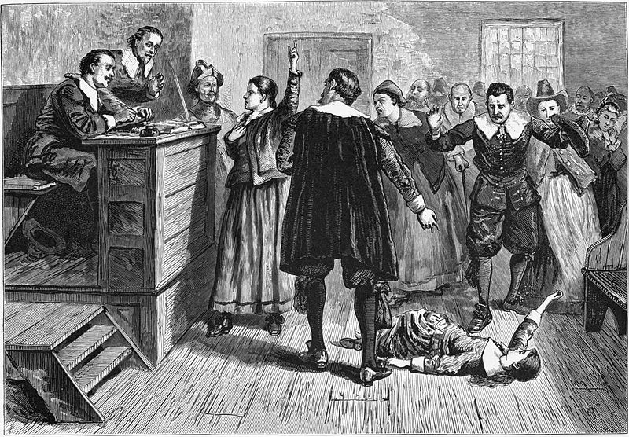

Slide 8
Political
The puritans established a theocratic government with the franchise limited to church members.¹
The governor John Winthrop ¹
Deputy gov Thomas Dudley ¹
King charles 1 made the decisions when he told somebody to do something they did it.¹
Encyclopedia Britannica. (2018). Massachusetts Bay Colony | Facts, Map, & Significance. [online] Available at: https://www.britannica.com/place/Massachusetts-Bay-Colony [Accessed 21 Sep. 2018].¹

Slide 9
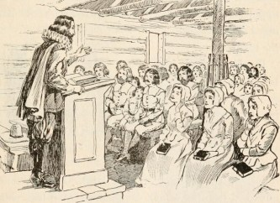

Slide 10
Economic
Many people made livings by fishing, agriculture, trade, limbering, etc.
Goods like fish, timber, furs, ships and livestock were exported ¹
Since the soil was so poor they could not plant crops like wheat, but corn, pumpkins, rye, squash, and beans could be planted ¹
Since it was hard to plant crops like wheat it was difficult to make things like bread
Landofthebrave.info. (2018). Massachusetts Colony ***. [online] Available at: https://www.landofthebrave.info/massachusetts-colony.htm [Accessed 24 Sep. 2018]. ¹

Slide 11
