Slide 1
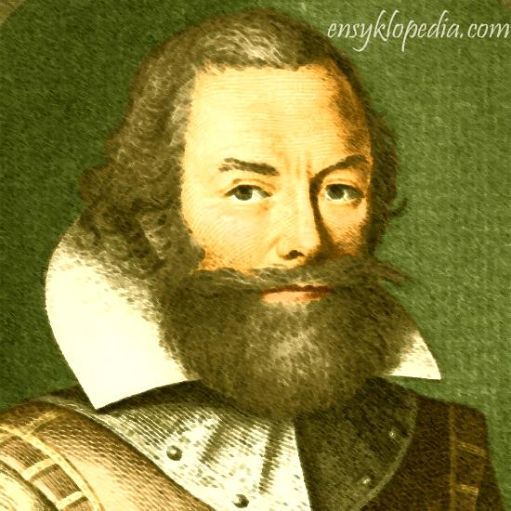
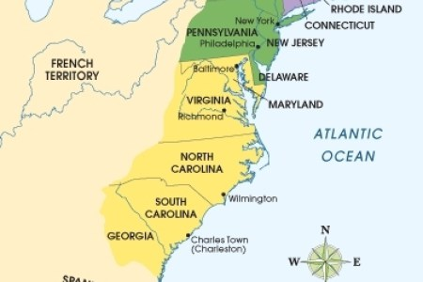
Colonial Virginia
By: Jayvion, Taylor, Jymiere, Aaron

Slide 2
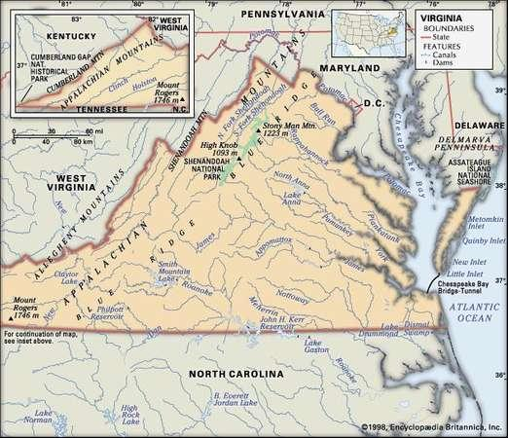
Geographic Founded in 1607
Colonial Virginia was full of mountains, valleys, and coastal plains.¹
Hot and humid summers allowed for disease to spread quickly.¹
Due to all around good weather, farming wa made a lot easier.¹
Virginia had cold, mild winters that didn’t carry a high death toll.¹
¹Virginia Colony ***". Landofthebrave.Info, 2018, https://www.landofthebrave.info/virginia-colony.htm. Accessed 27 Sept 2018.

Slide 3
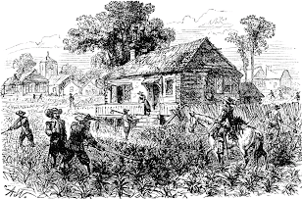
Demographic
1st of the 13 colonies in 1610, population was 350 people¹
Many who lived in virginia were great craftsmen ( blacksmiths, carpenters, and bricklayers)¹
John Rolfe introduced a tobacco plant, then people in virginia started trading it locally over land and overseas ¹
¹Sites.google.com. (2018). Demographics - Virginia Colony. [online] Available at: https://sites.google.com/site/virginiacolonyyy/home/demographics [Accessed 27 Sep. 2018].

Slide 4
Social/Cultural
Women in Virginia were to provide the stability needed for Jamestown's survival was the indispensable role played by Virginia women.¹
The colonists were legally required to attend its services and support the ministers financially through taxes.¹ Virginians were not tolerant of non-Christian religions.²
Law breakers were sometimes branded,burned, shot to death, starved to death, hanged, whipped, and forced to work as slaves.³
¹The Indispensable Role Of Women At Jamestown - Historic Jamestowne Part Of Colonial National Historical Park (U.S. National Park Service)". Nps.Gov, 2018, https://www.nps.gov/jame/learn/historyculture/the-indispensible-role-of-women-at-jamestown.htm. Accessed 21 Sept 2018.
²Religion In Early Virginia". History.Org, 2018, http://www.history.org/almanack/life/religion/religionva.cfm. Accessed 21 Sept 2018.
³Colonial Crimes And Punishments". History.Org, 2018, http://www.history.org/foundation/journal/spring03/branks.cfm. Accessed 26 Sept 2018

Slide 5
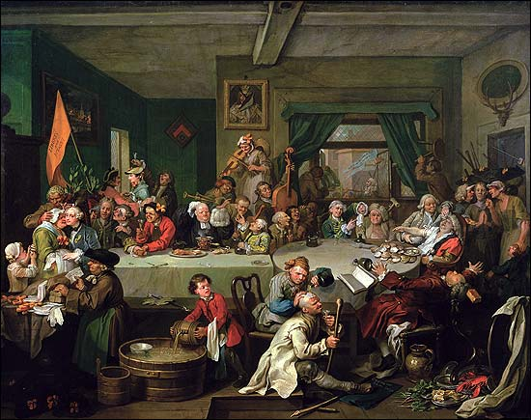
Political
The government was set up by enacting laws.”Royal governors acting on behalf of the Crown shared responsibility with locally elected representatives of the colony's population, the House of Burgesses as well as the councillors chosen by the governor, who together formed the General Assembly, and who enacted laws to govern the colony”.¹
The General Assembly made the decisions by making laws.¹
¹Lva.virginia.gov. (2018). Colonial Virginia. [online] Available at: http://www.lva.virginia.gov/exhibits/political/colonial.htm [Accessed 27 Sep. 2018].

